Slide 1
Learning intentions and success criteria
I am learning…
I can…
About copyright legislation
How to identify and avoid copyright infringement
Describe the Copyright, Designs and Patents Act (1988)
Identify examples of copyright infringement

Slide 2

Copyright
NPA Digital Media (Level 5)

Slide 3
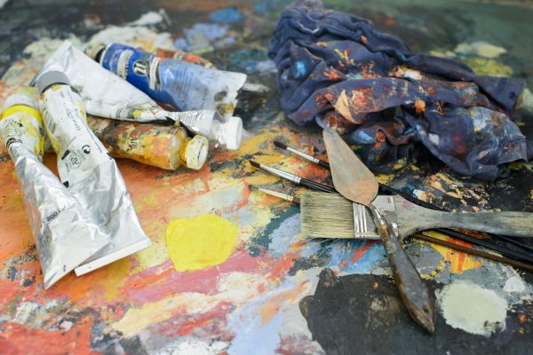

What is Copyright?
Copyright is a legal right that protects an author's original creative works.
Such works include:
Books
Music
Art
DIGITAL MEDIA!
Authors are protected by giving them exclusive control over how their work is used and reproduced.

Slide 4


The Copyright, Designs and Patents Act (1988)
Current UK copyright law:
It gives the creators of literary, dramatic, musical and artistic works the right to control the ways in which their material may be used.
The rights cover:
Broadcast
Public performance
Copying
Adapting
Issuing
Renting
Lending

Slide 5
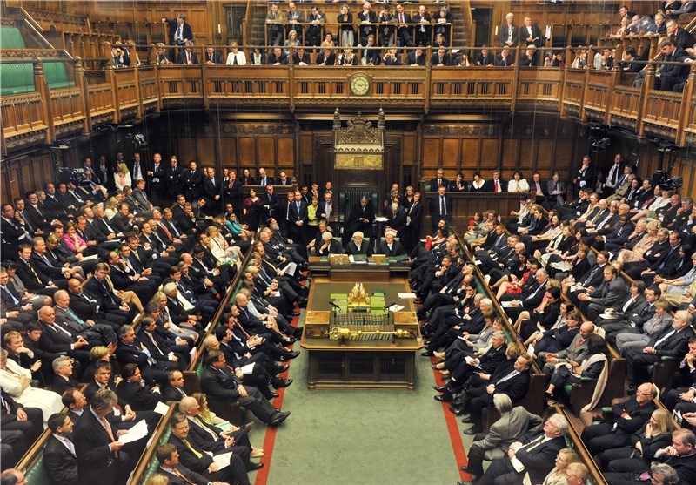

How Do I copyright my Work?
In the UK, copyright protection is automatic:
You don't need to register it or pay a fee
Protection begins when you create original literary, dramatic, musical, or artistic work and fix it in a tangible form, like writing it down or saving it to a computer
While you can use a copyright symbol (©), it doesn't affect the level of protection you have

Slide 6

Duration of Rights
Photography comes under the literacy category of works:
“70 years from the end of the calendar year in which the last remaining author of the work dies, or the work is made available to the public, by authorised performance, broadcast, exhibition, etc.”

Slide 7
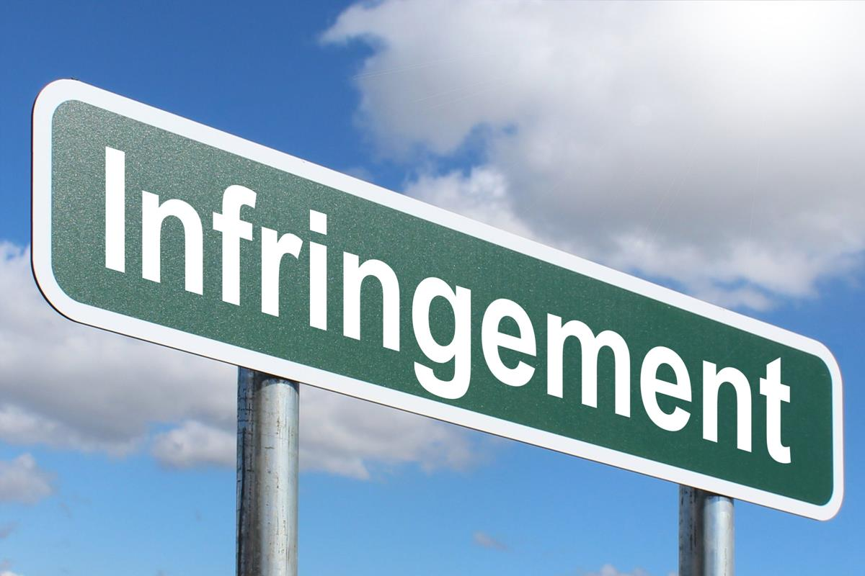
Copyright Infringement
Copyright infringement is the unauthorized use of copyrighted material, without the copyright owner's permission, unless an exception applies.
The next few slides covers some examples of copyright infringement.
These examples will be in the context of Still Images.

Slide 8
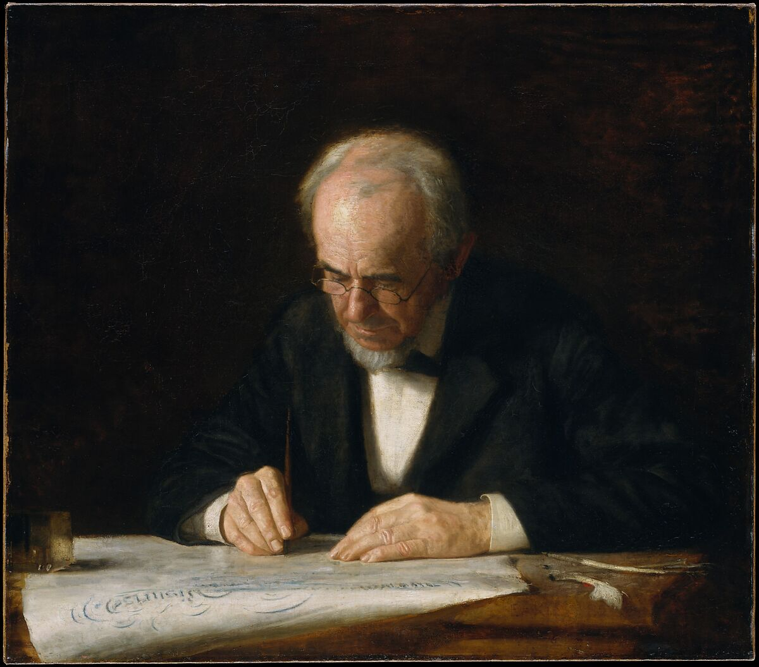
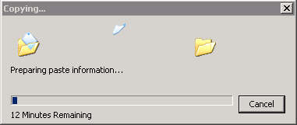
Copying without Permission
Reproducing photographs in print:
e.g. scanning a professional photographer’s image from a magazine and using it in a brochure without consent.
Copying digital images online:
e.g. downloading an image from a stock photo site without a licence and re-uploading it to your own website.

Slide 9
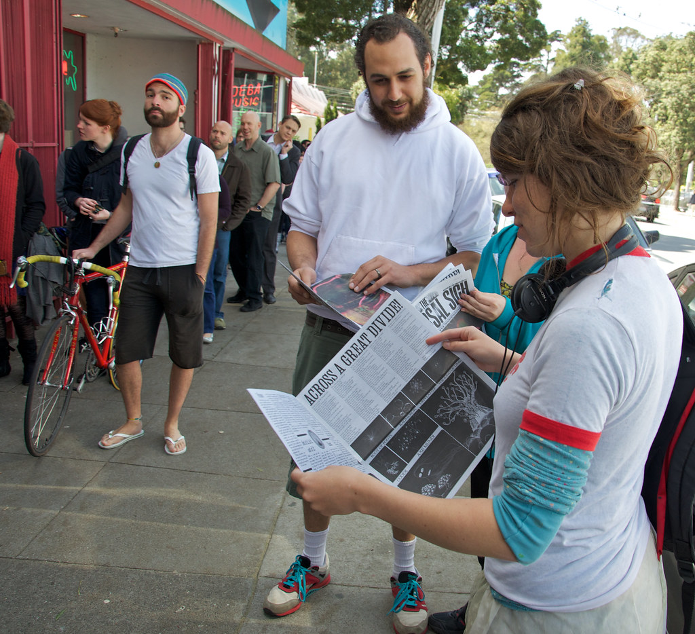

Issuing copies to the public
Selling prints of someone else’s artwork or photographs without a licence.
Sharing unlicensed images in commercial materials
e.g. leaflets, adverts or merchandise

Slide 10


Communicating to the public / making available online
Uploading copyrighted artwork to social media or a website without permission (even if not for profit).
e.g. Using another artist’s illustration in a blog post or online portfolio without a licence or exception.

Slide 11
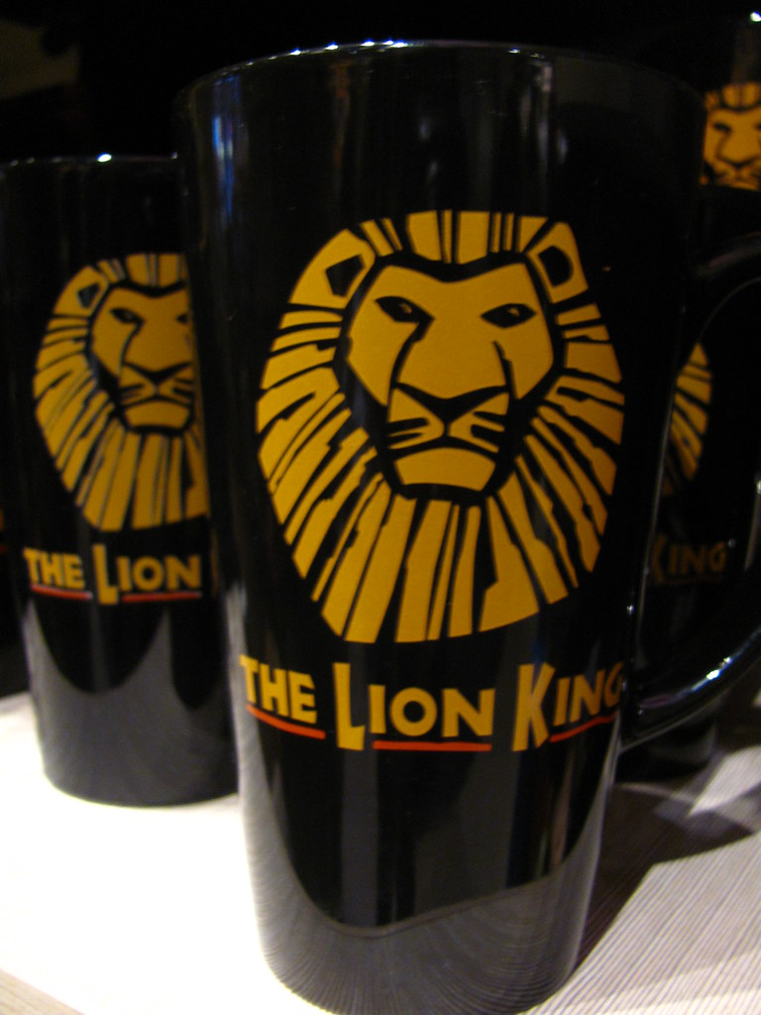

Adaptations / derivative works
Altering an existing photograph or illustration (e.g. applying filters, cropping, combining it in a collage) and publishing it without permission.
e.g. Turning a drawing into merchandise (t-shirts, posters, mugs) without the creator’s consent.

Slide 12
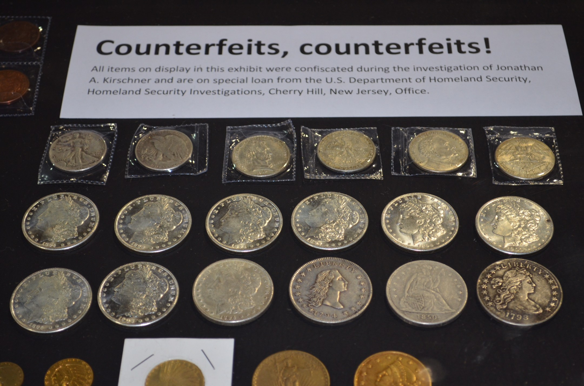
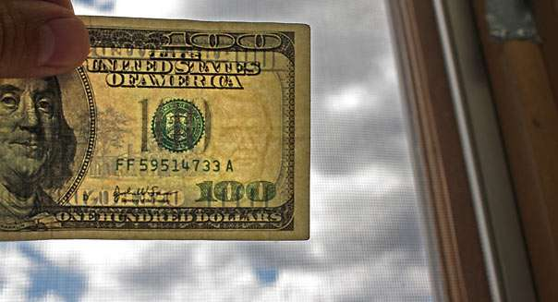
Secondary infringement (dealing in infringing copies)
Importing posters or prints that reproduce someone else’s protected image without licence.
e.g. taking a work which infringes copyright and publishing it yourself
Selling counterfeit art prints or image-based merchandise knowing (or having reason to suspect) they are infringing.

Slide 13

Not Infringement
Some uses of still images might be covered by permitted acts, such as:
Fair dealing for criticism or review (e.g. quoting part of an image in an article reviewing an exhibition, with acknowledgement).
Fair dealing for parody, caricature or pastiche, if the use is genuinely transformative and fair.
Incidental inclusion (e.g. a painting appearing in the background of a documentary shot).

Slide 14
Learning intentions and success criteria
I am learning…
I can…
About copyright legislation in the UK
How to identify and avoid copyright infringement
Describe the Copyright, Designs and Patents Act (1988)
Identify examples of copyright infringement

